Slide 1
Smart Home
Embedded system _Final Project

Slide 2
Team Members
Ali Ahmed
Moataz Talat
Rami Osama
Hussein Khalid
Aya Al-Mowafy

Slide 3
System Block Diagram
Control System
Air conditioning system
Security System
Lighting system
Wireless Communication System

Slide 4
System Components
Temperature sensor (LM35)
5 LEDs
ADC
EEPROM
LCD
Keypad
Bluetooth Module
“List up any missed components”

Slide 5
Tools
Proteus
Eclipse IDE
“List up any more tools”

Slide 6
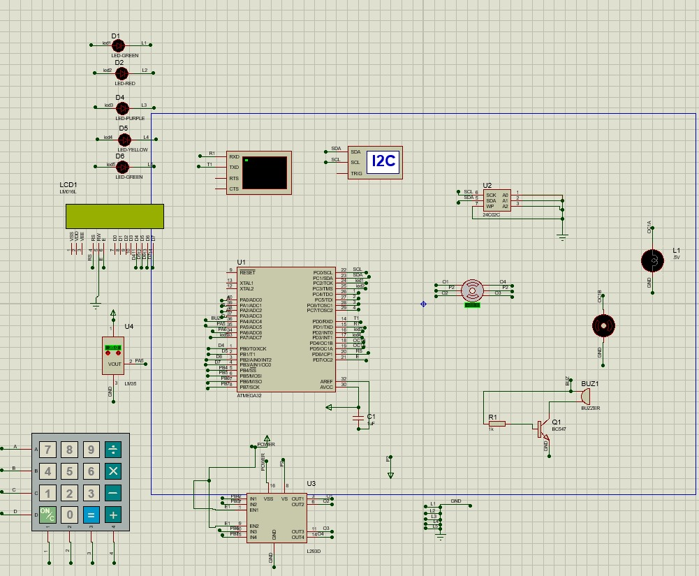
Circuit Diagram

Slide 7
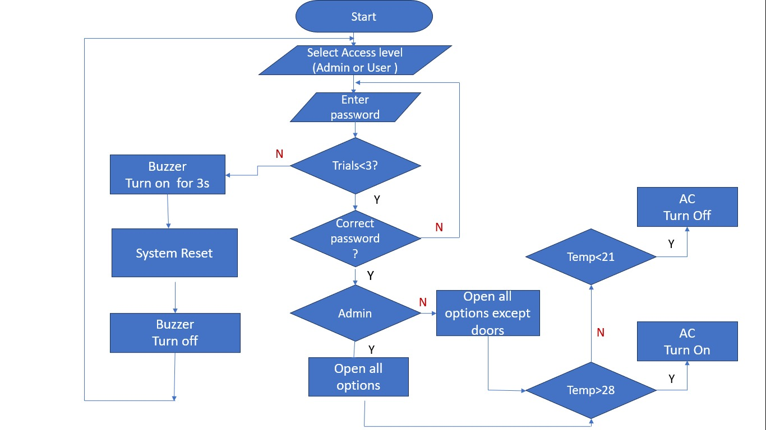
flow chart digram

